Slide 1
WAN INTRODUCTION

Slide 2
LANs and WANs
A WAN is a telecommunications network that spans over a relatively large geographical area and is required to connect beyond the boundary of the LAN.
Local Area Networks (LANs) | Wide Area Networks (WANs)
LANs provide networking services within a small geographic area. | WANs provide networking services over large geographical areas.
LANs are used to interconnect local computers, peripherals, and other devices. | WANs are used to interconnect remote users, networks, and sites.
A LAN is owned and managed by an organization or home user. | WANs are owned and managed by internet service, telephone, cable, and satellite providers.
Other than the network infrastructure costs, there is no fee to use a LAN. | WAN services are provided for a fee.
LANs provide high bandwidth speeds using wired Ethernet and Wi-Fi services. | WANs providers offer low to high bandwidth speeds, over long distances.

Slide 3
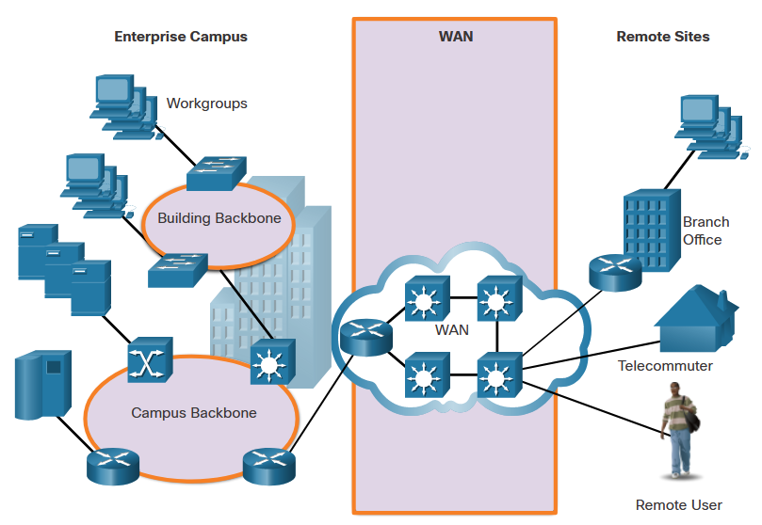
LANs and WANs

Slide 4
WAN Topologies
WANs are implemented using the following logical topology designs:
Point-to-Point Topology
Hub-and-Spoke Topology
Dual-homed Topology
Fully Meshed Topology
Partially Meshed Topology
Note: Large networks usually deploy a combination of these topologies.

Slide 5
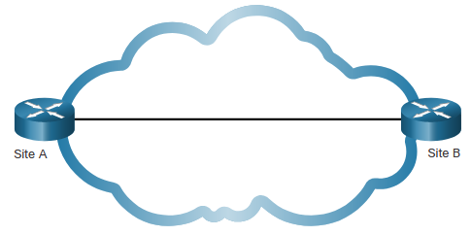
WAN Topologies (Cont.)
Point-to-Point Topology
Employs a point-to-point circuit between two endpoints.
Involves a Layer 2 transport service through the service provider network.
The point-to-point connection is transparent to the customer network.
Note: It can become expensive if many point-to-point connections are required.

Slide 6
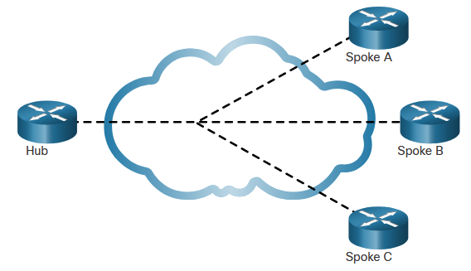
WAN Topologies (Cont.)
Hub-and-Spoke Topology
Enables a single interface on the hub router to be shared by all spoke circuits.
Spoke routers can be interconnected through the hub router using virtual circuits and routed subinterfaces.
Spoke routers can only communicate with each other through the hub router.
Note: The hub router represents a single point of failure. If it fails, inter-spoke communication also fails.

Slide 7
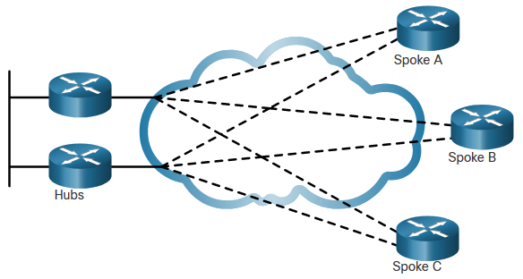
WAN Topologies (Cont.)
Dual-homed Topology
Offers enhanced network redundancy, load balancing, distributed computing and processing, and the ability to implement backup service provider connections.
More expensive to implement than single-homed topologies. This is because they require additional networking hardware, such as additional routers and switches.
More difficult to implement because they require additional, and more complex, configurations.

Slide 8
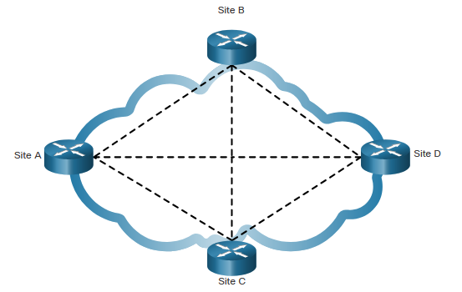
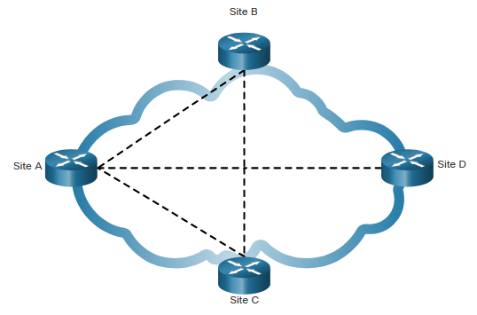
WAN Topologies (Cont.)
Fully Meshed Topology
Uses multiple virtual circuits to connect all sites
The most fault-tolerant topology
Partially Meshed Topology
Connects many but not all sites

Slide 9
Carrier Connections
Another aspect of WAN design is how an organization connects to the internet. An organization usually signs a service level agreement (SLA) with a service provider. The SLA outlines the expected services relating to the reliability and availability of the connection.
The service provider may or may not be the actual carrier. A carrier owns and maintains the physical connection and equipment between the provider and the customer. Typically, an organization will choose either a single-carrier or dual-carrier WAN connection.

Slide 10
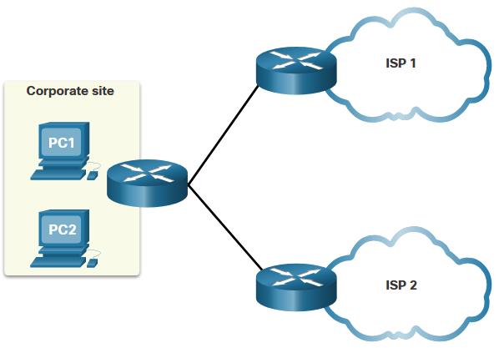
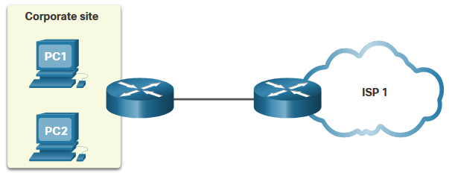
Carrier Connections (Cont.)
A single-carrier connection is when an organization connects to only one service provider. An SLA is negotiated between the organization and the service provider.
A dual-carrier connection provides redundancy and increases network availability. The organization negotiates separate SLAs with two different service providers.

Slide 11
Evolving Networks
Network requirements of a company can change dramatically as the company grows over time.
A network must meet the day-to-day operational needs of business, and it must be able to adapt and grow as a company changes.
Network designers and administrators meet these challenges by carefully choosing network technologies, protocols, and service providers.
Networks can be optimized by using a variety of network design techniques and architectures.
To illustrate differences between network size, we will use a fictitious company called SPAN Engineering as it grows from a small, local, business into a global enterprise.

Slide 12
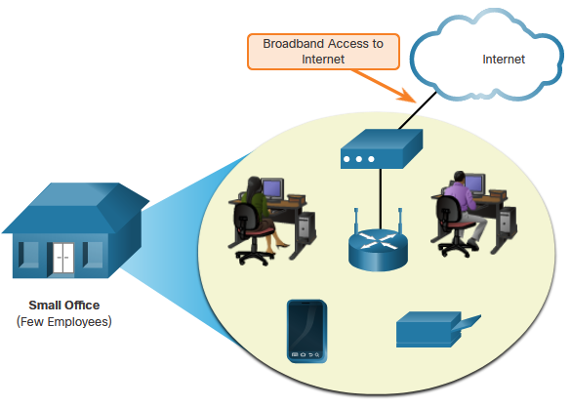
Evolving Networks (Cont.)
Small Network
SPAN, a small fictitious company, started with a few employees in a small office.
Uses a single LAN connected to a wireless router for sharing data and peripherals.
Connection to the internet is through a common broadband service called Digital Subscriber Line (DSL)
IT support is contracted from the DSL provider.

Slide 13
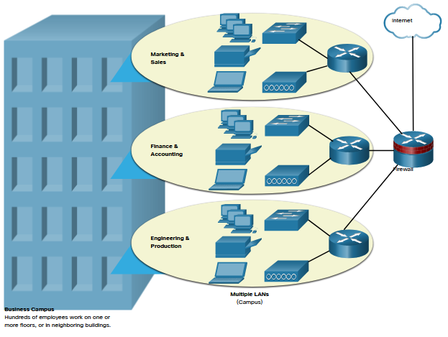
Evolving Networks (Cont.)
Campus Network
Within a few years SPAN grew and required several floors of a building.
The company now required a Campus Area Network (CAN).
A firewall secures internet access to corporate users.
In-house IT staff to support and maintain the network.

Slide 14
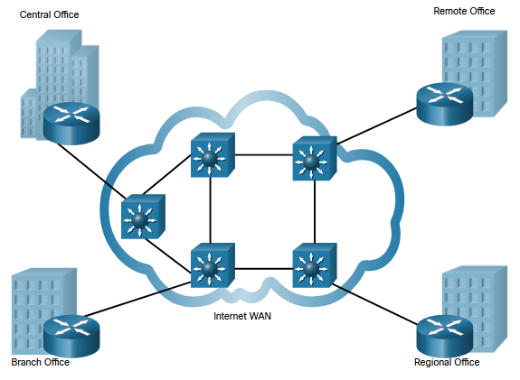
Evolving Networks (Cont.)
Branch Network
A few years later, the company expanded and added a branch site in the city, and remote and regional sites in other cities.
The company now required a metropolitan area network (MAN) to interconnect sites within the city.
To connect to the central office, branch offices in nearby cities used private dedicated lines through their local service provider.

Slide 15
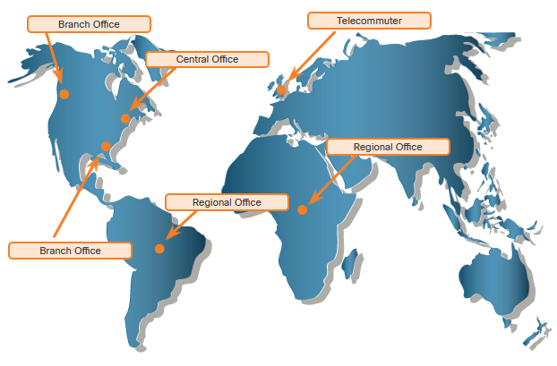
Evolving Networks (Cont.)
Distributed Network
SPAN Engineering has now been in business for 20 years and has grown to thousands of employees distributed in offices worldwide.
Site-to-site and remote access Virtual Private Networks (VPNs) enable the company to use the internet to connect easily and securely with employees and facilities around the world.

Slide 16
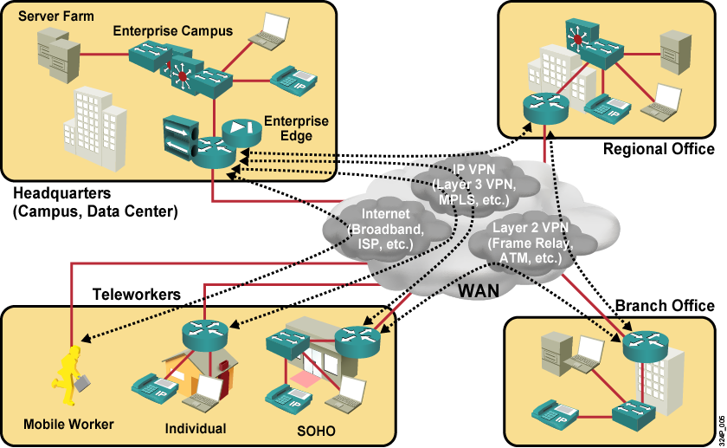
WAN Operations

Slide 17
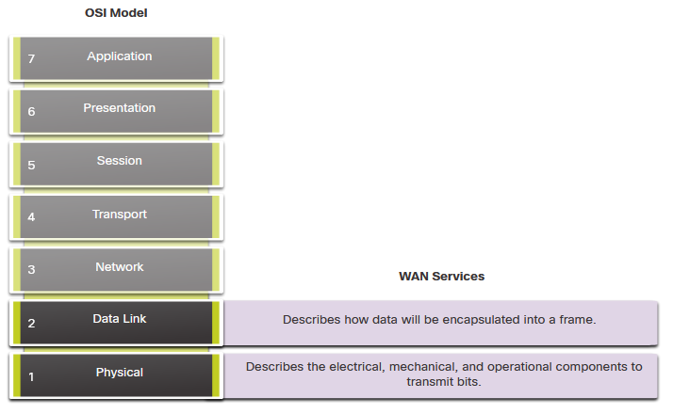
WANs in the OSI Model
Most WAN standards focus on the physical layer
and the data link layer.
Layer 1 Protocols
Synchronous Digital Hierarchy (SDH)
Synchronous Optical Networking (SONET)
Dense Wavelength Division Multiplexing (DWDM)
Layer 2 Protocols
Broadband (i.e., DSL and Cable)
Wireless
Ethernet WAN (Metro Ethernet)
Multiprotocol Label Switching (MPLS)
Point-to-Point Protocol (PPP) (less used)
High-Level Data Link Control (HDLC) (less used)
Frame Relay (legacy)
Asynchronous Transfer Mode (ATM) (legacy)

Slide 18
SDH, SONET, and DWDM
Service provider networks use fiber-optic infrastructures to transport user data between destinations.
There are two optical fiber OSI layer 1 standards available to service providers:
SDH - Synchronous Digital Hierarchy (SDH) is a global standard for transporting data over fiber-optic cable.
SONET - Synchronous Optical Networking (SONET) is the North American standard that provides the same services as SDH.
SDH/SONET define how to transfer multiple data, voice, and video communications over optical fiber using lasers or light-emitting diodes (LEDs) over great distances.
Dense Wavelength Division Multiplexing (DWDM) is a newer technology that increases the data-carrying capacity of SDH and SONET by simultaneously sending multiple streams of data (multiplexing) using different wavelengths of light.

Slide 19
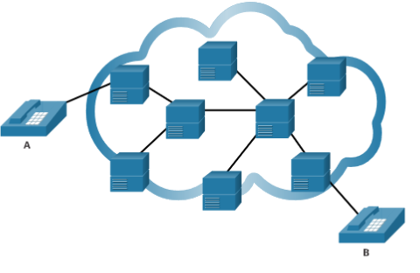
Circuit-Switched Communication
A circuit-switched network establishes a dedicated circuit (or channel) between endpoints before the users can communicate.
Establishes a dedicated virtual connection through the service provider network before communication can start.
All communication uses the same path.
The two most common types of circuit-switched WAN technologies are the public switched telephone network (PSTN) and the legacy Integrated Services Digital Network (ISDN).

Slide 20
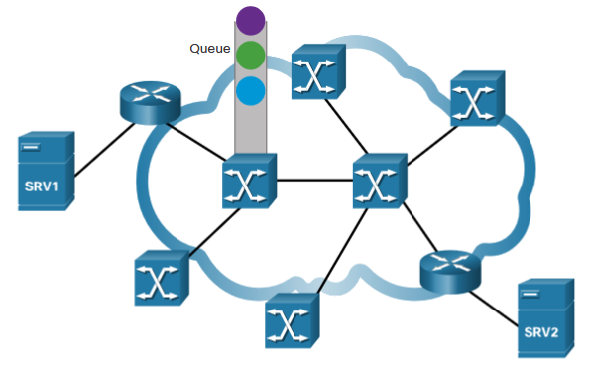
Packet-Switched Communication
Network communication is most commonly implemented using packet-switched communication.
Segments traffic data into packets that are routed over a shared network.
Much less expensive and more flexible than circuit switching.
Common types of packet-switched WAN technologies are:
    Ethernet WAN (Metro Ethernet)
    Multiprotocol Label Switching (MPLS)
    Frame Relay
    Asynchronous Transfer Mode (ATM).

Slide 21
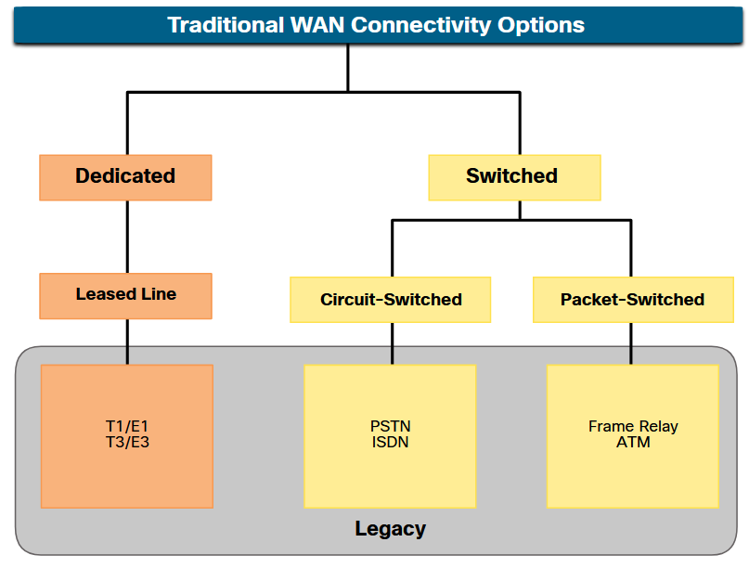
Traditional WAN Connectivity
Point-to-point lines could be leased from a service provider and were called “leased lines”. The term refers to the fact that the organization pays a monthly lease fee to a service provider to use the line.
Leased lines are available in different fixed capacities and are generally priced based on the bandwidth required and the distance between the two connected points.
There are two systems used to define the digital capacity of a copper media serial link:
  T-carrier - Used in North America, provides T1 links supporting bandwidth up to 1.544 Mbps and T3 links supporting bandwidth up to 43.7 Mbps.
  E-carrier – Used in Europe, provides E1 links supporting bandwidth up to 2.048 Mbps and E3 links supporting bandwidth up to 34.368 Mbps.

Slide 22
Leased lines.
The table summarizes the advantages and disadvantages of leased lines.
Advantages
Simplicity | Point-to-point communication links require minimal expertise to install and maintain.
Quality | Point-to-point communication links usually offer high quality service, if they have adequate bandwidth.
Availability | Constant availability is essential for some applications, such as e-commerce. Point-to-point communication links provide permanent, dedicated capacity which is required for VoIP or Video over IP.
Disadvantages
Cost | Point-to-point links are generally the most expensive type of WAN access. The cost of leased line solutions can become significant when they are used to connect many sites over increasing distances.
Limited flexibility | WAN traffic is often variable, and leased lines have a fixed capacity, so that the bandwidth of the line seldom matches the need exactly.

Slide 23
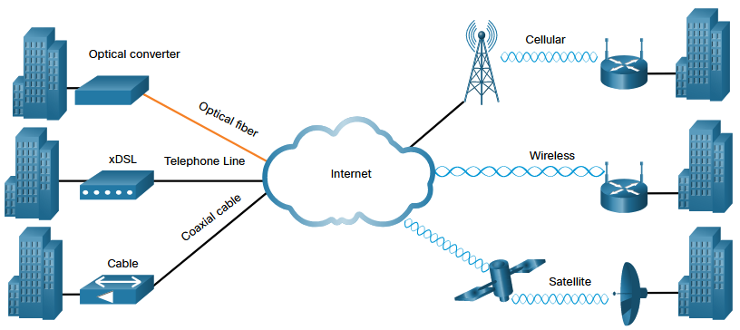
Modern WAN Connectivity
Modern WANS have more connectivity options than traditional WANs.
Enterprises now require faster and more flexible WAN connectivity options.
Traditional WAN connectivity options have rapidly declined in use because they are either no longer available, too expensive, or have limited bandwidth.
The figure displays the local loop connections most likely encountered today.

Slide 24
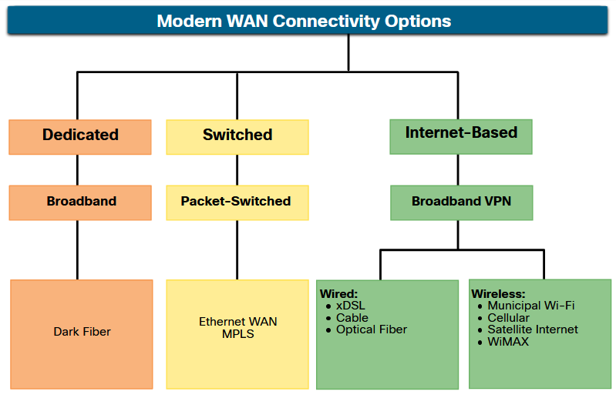
Modern WAN Connectivity Options
New technologies are continually emerging. The figure summarizes the modern WAN connectivity options.
Dedicated broadband
Fiber can be installed independently by an organization to connect remote locations directly together.
Dark fiber can be leased or purchased from a supplier.
Packet-switched
Metro Ethernet – Replacing many traditional WAN options.
MPLS – Enables sites to connect to the provider regardless of its access technologies.
Internet-based broadband
Organizations are now commonly using the global internet infrastructure for WAN connectivity.

Slide 25
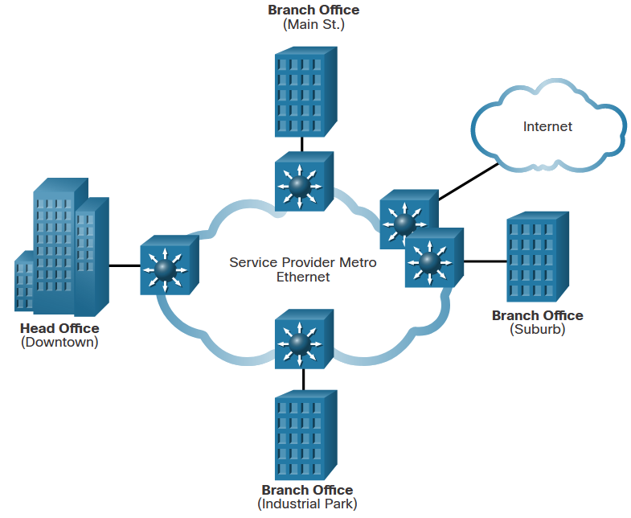
Ethernet WAN
Service providers now offer Ethernet WAN service using fiber-optic cabling.
The Ethernet WAN service can go by many names, including the following:
Metropolitan Ethernet (Metro E)
Ethernet over MPLS (EoMPLS)
Virtual Private LAN Service (VPLS)
There are several benefits to an Ethernet WAN:
Reduced expenses and administration
Easy integration with existing networks
Enhanced business productivity
Note: Ethernet WANs have gained in popularity and are now commonly being used to replace the traditional serial point-to-point, Frame Relay and ATM WAN links.

Slide 26
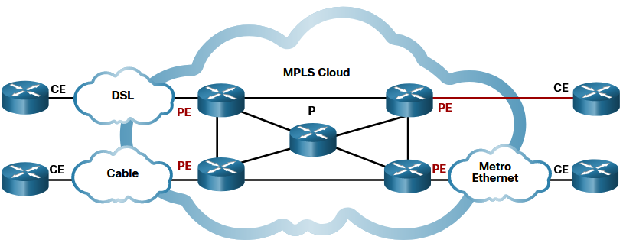
MPLS
Multiprotocol Label Switching (MPLS) is a high-performance service provider WAN routing technology to interconnect clients without regard to access method or payload.
MPLS supports a variety of client access methods (e.g., Ethernet, DSL, Cable, Frame Relay).
MPLS can encapsulate all types of protocols including IPv4 and IPv6 traffic.
An MPLS router can be a customer edge (CE) router, a provider edge (PE) router, or an internal provider (P) router.
MPLS routers are label switched routers (LSRs). They attach labels to packets that are then used by other MPLS routers to forward traffic.
MPLS also provides services for QoS support, traffic engineering, redundancy, and VPNs.

Slide 27
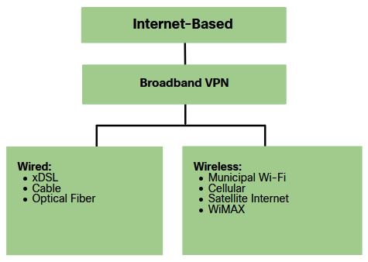
Internet-Based Connectivity
Internet-based broadband connectivity is an alternative to using dedicated WAN options.
Internet-based connectivity can be divided into wired and wireless options.
Wired Options
Wired options use permanent cabling (e.g., copper or fiber) to provide consistent bandwidth, and reduce error rates and latency. Examples: DSL, cable connections, and optical fiber networks.
Wireless Options
Wireless options are less expensive to implement compared to other WAN connectivity options because they use radio waves instead of wired media to transmit data. Examples: cellular 3G/4G/5G or satellite internet services.
Wireless signals can be negatively affected by factors such as distance from radio towers, interference from other sources and weather.

Slide 28
Wireless Internet-Based Broadband
Wireless technology uses the unlicensed radio spectrum to send and receive data.
Municipal Wi-Fi - Municipal wireless networks are available in many cities providing high-speed internet access for free, or for substantially less than the price of other broadband services.
Cellular – Increasingly used to connect devices to the internet using radio waves to communicate through a nearby mobile phone tower. 3G/4G/5G and Long-Term Evolution (LTE) are cellular technologies.
Satellite Internet - Typically used by rural users or in remote locations where cable and DSL are not available. A router connects to a satellite dish which is pointed to a service provider satellite in Geosynchronous orbit. Trees and heavy rains can impact the satellite signal.
WiMAX - Worldwide Interoperability for Microwave Access (WiMAX) is described in the IEEE standard 802.16 Provides high-speed broadband service with wireless access and provides broad coverage like a cell phone network rather than through small Wi-Fi hotspots

Slide 29
Optical Fiber
Many municipalities, cities, and providers install fiber-optic cable to the user location. This is commonly referred to as Fiber to the x (FTTx) and includes the following:
Fiber to the Home (FTTH) - Fiber reaches the boundary of the residence.
Fiber to the Building (FTTB) - Fiber reaches the boundary of the building with the final connection to the individual living space being made via alternative means.
Fiber to the Node/Neighborhood (FTTN) – Optical cabling reaches an optical node that converts optical signals to a format acceptable for twisted pair or coaxial cable to the premise.
Note: FTTx can deliver the highest bandwidth of all broadband options

Slide 30
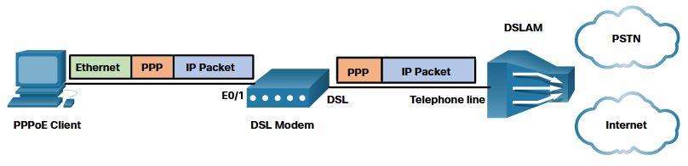
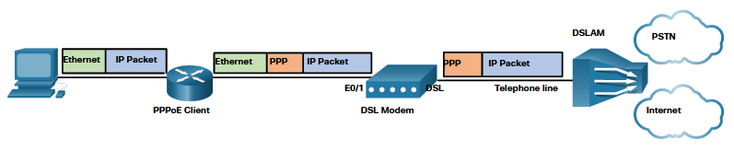
DSL and PPP
ISPs use PPP as the Layer 2 protocol for broadband DSL connections.
PPP can be used to authenticate the subscriber.
PPP can assign a public IPv4 address to the subscriber.
PPP provides link-quality management features.
There are two ways PPP over Ethernet (PPPoE) can be deployed:
Host with PPoE Client - The PPPoE client software communicates with the DSL modem using PPPoE and the modem communicates with the ISP using PPP.
Router PPPoE Client - The router is the PPPoE client and obtains its configuration from the provider.

Slide 31
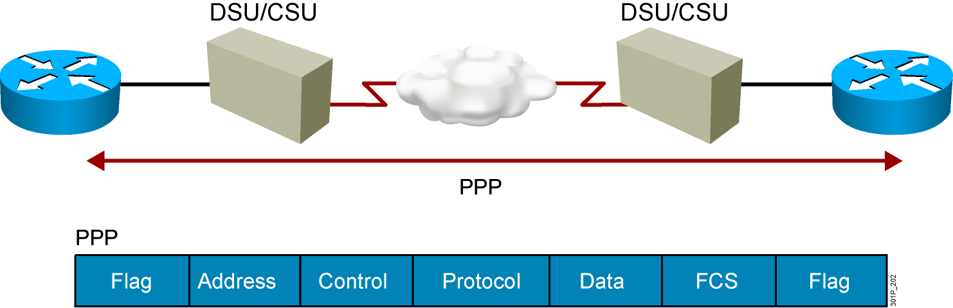
An Overview of PPP
  PPP can carry packets from several protocol suites using NCP.
  PPP controls the setup of several link options using LCP.
Notes:
Purpose: This figure presents an overview of PPP.
Emphasize: The figure illustrates the multiple protocols that NCP supports.
The two arrows pointing to the router interfaces are where PPP encapsulation occurs.
The first bullet summarizes the role of NCP. The second bullet summarizes the role of the LCP options that the administrator can use to set up and control the data link.
Several RFCs are used to specify aspects of PPP. RFC 1548 is the major specification for the major PPP NCP and LCP operations.

Slide 32
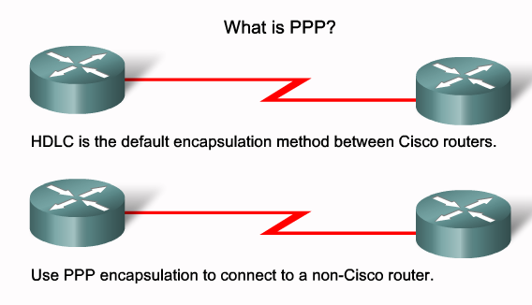
PPP

Slide 33
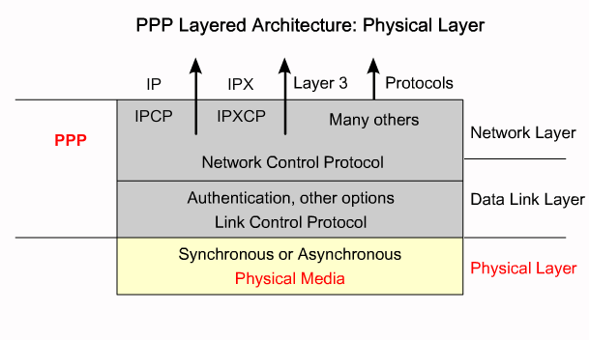
PPP PHYSICAL LAYER

Slide 34
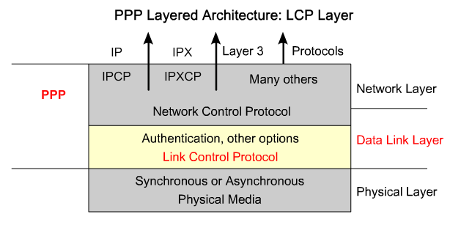
LCP

Slide 35
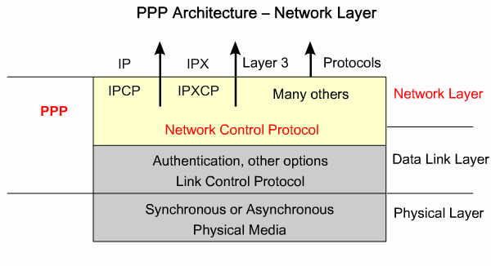
NCP

Slide 36
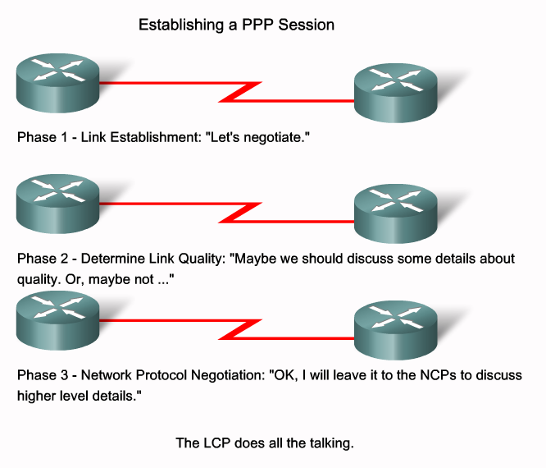
Establishing a PPP Session

Slide 37
Authentication
Authentication means to put a username and password before accessing the network.
There is two authentication protocols:
  PAP (Password Authentication Protocol).
  CHAP (Challenge Handshake Authentication Protocol).

Slide 38
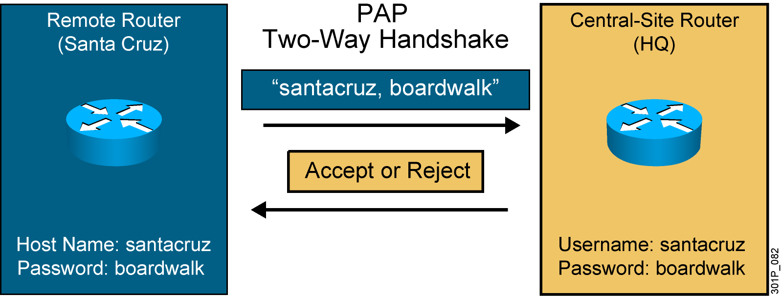
PPP Authentication Protocols: PAP
Passwords sent in plaintext
Peer in control of attempts
Notes:
Slide 1 of 2
Purpose: This figure presents the PPP authentication protocol, PAP.
Emphasize: PPP sets line controls for the call.
There are two types of authentication protocols: PAP and CHAP.
PAP provides a simple method for a remote node to establish its identity using a two-way handshake.
PAP is done only upon initial link establishment.
PAP is not a strong authentication protocol. It provides no encryption. It may be fine in DDR environments when the password changes each time a user authenticates.
CHAP is the preferred protocol.

Slide 39
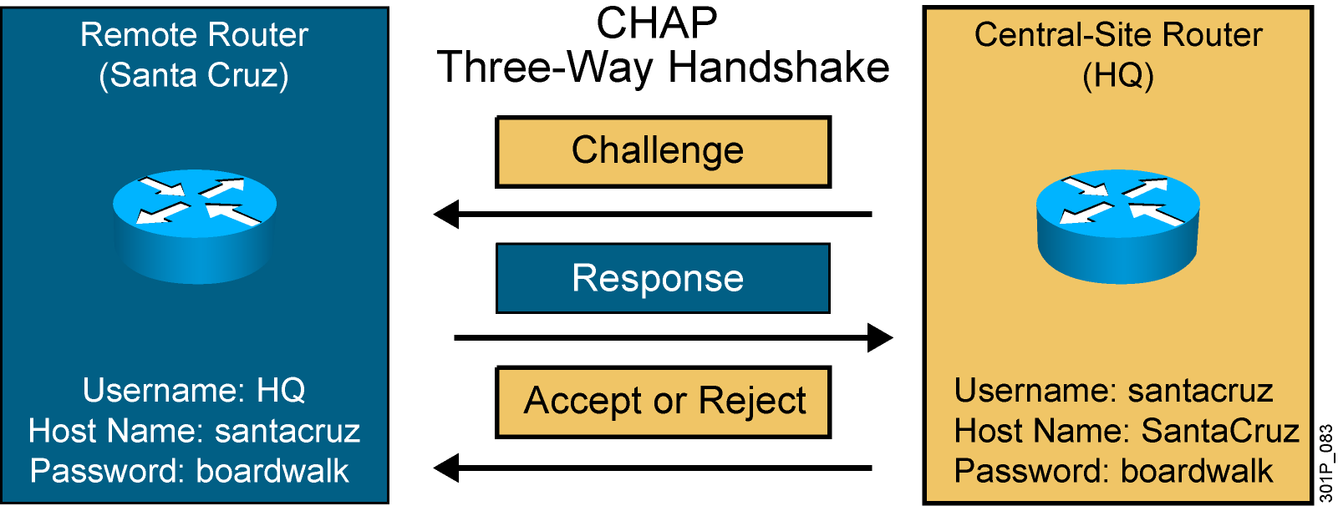
PPP Authentication Protocols: CHAP
This is an example of the Santa Cruz router authenticating to the HQ router.
Hash values, not actual passwords, are sent across the link.
The local router or external server is in control of authentication attempts.
Notes:
Slide 2 of 2
Purpose: This figure presents the PPP authentication protocol, CHAP.
Emphasize: CHAP is done upon initial link establishment and can be repeated any time after the link has been established.
CHAP transactions occur only when a link is established. The local access server does not request a password during the rest of the session. (The local access server can, however, respond to such requests from other devices during a session.)
CHAP is specified in RFC 1334. It is an additional authentication phase of the PPP Link Control Protocol.
Transition: Now that you know how PPP and PPP authentication operate, the following section describes how to configure these on a Cisco IOS router.

Slide 40
PPPoE

Slide 41
PPP over Ethernet
  Ethernet frame carrying PPP frame
  Service provider end:
    DSLAM for DSL connection termination
    Aggregation router for PPP session termination
  Subscriber end:
    DSL modem for DSL connection termination
    PPPoE client for PPP session termination
  The client device is the PC or the router at the CPE

Slide 42
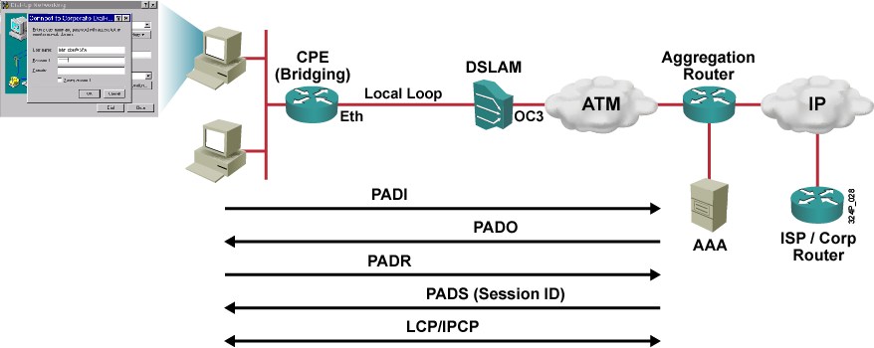
PPPoE Session Establishment
  PPP session is from PPPoE client to the aggregation router.
  Subscriber IP address is assigned by the aggregation router via IPCP.
Notes:
There are four steps to the discovery stage:
Step 1 The PPPoE client (end-user PC or router) broadcasts a PPPoE Active Discovery Initiation (PADI) packet containing an indication of which service type it is requesting. The destination MAC address is set to broadcast.
Step 2 The PPPoE server (aggregation router) sends a PPPoE Active Discovery Offer (PADO) packet describing which service it can offer. The destination MAC address is the unicast address of the client (end-user PC or router).
Step 3 The PPPoE client sends a unicast PPPoE Active Discovery Request (PADR) packet to the PPPoE server.
Step 4 The PPPoE server sends a unicast PPPoE active discovery session-confirmation (PADS) packet to the client.

Slide 43
PPPoE Client Configuration
  PPPoE Client:
Client(config)#interface dialer 0
Client(config-if)#encapsulation ppp
Client(config-if)#ip address negotiated
Client(config-if)#ppp pap sent-username user1 password cisco
Client(config-if)#dialer pool 1
Client(config)#interface g1
Client(config-if)#pppoe-client dial-pool-number 1

Slide 44
PPPoE Verification
  Ping successfully:
Client#ping 8.8.8.8
Type escape sequence to abort.
Sending 5, 100-byte ICMP Echos to 8.8.8.8, timeout is 2 seconds:
!!!!!
Success rate is 100 percent (5/5), round-trip min/avg/max = 12/20/30 ms

Slide 45
PPPoE Verification
Client#show pppoe session
1 client session
Uniq ID PPPoE RemMAC Port VT VA State
SID LocMAC VA-st
N/A 18 000c.297c.c044 G1 Di0 Vi1 UP
000c.297c.d19e UP

Slide 46
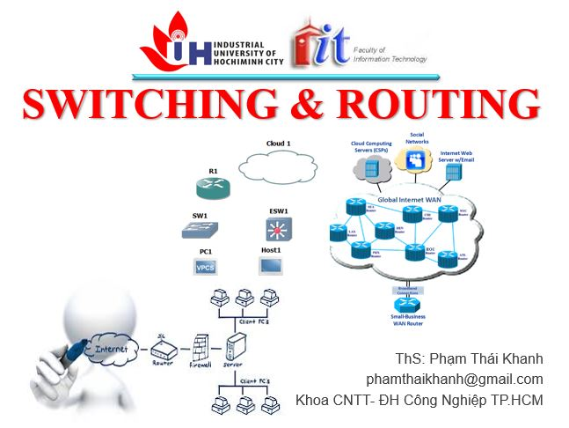


phamthaikhanh@gmail.com
This Photo by Unknown Author is licensed under CC BY-NC

